Slide 1
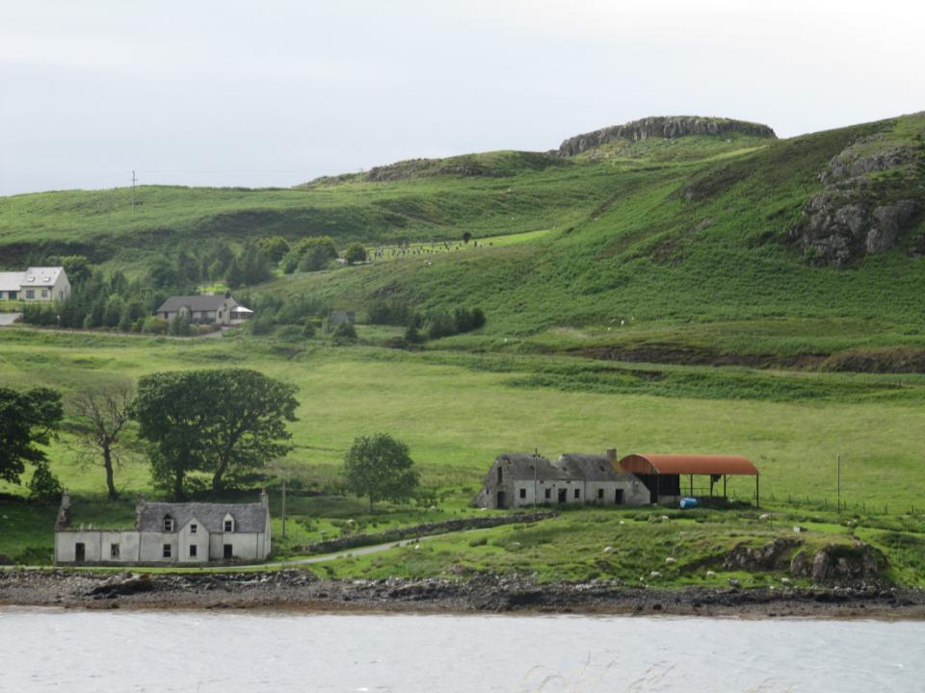
HNVF Farming in Scotland – farm characteristics and practices
Vyv Wood-Gee
Countryside Management Consultant
and Ken Taylor, Asken Ltd.

Slide 2
Research objectives
to determine farm management practices and land use characteristics associated with Type 2 HNVF
to identify any attributes strongly associated with HNVF that could be used as key indicators at a general level
Notes:
Scottish Government established a working group to develop HNV farmland and forestry baseline indicators for Scottish RDP 2007-13
Work by SAC (led by Davey McCraken) looking at farming systems
SNH looked at biodiversity, including mapping HNVF Types 1, 2 and 3 of which this contract was part
brief noted that HNVF Types 1 and 3 were relatively easy to identify, hence focus on Type 2

Slide 3
Methodology
6 case study areas on mainland Scotland
telephone interviews with 64 farmers and crofters
Face to face interviews with 18 of those already interviewed by telephone
Mapping comparison
Data analysis
(no physical survey work)
Notes:
Sample for in-depth interviews selected on basis of availability of interviewee, representativeness of farming or crofting system within the case study area, high likelihood of HNVF occurring on the holding(s) under discussion, based on initial telephone survey responses, scope for the further interview to generate additional relevant data.
Survey excluded HNVF Type 3 which is easily identified

Slide 4
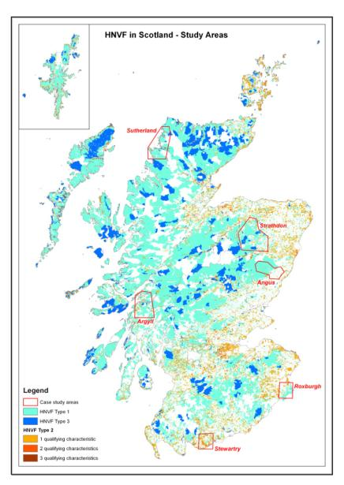
Selection of case study areas
Geographic spread around mainland Scotland
Representative of different farming types, systems and land cover
Based on SNH mapping distinguishing between HNVF Types 1, 2 and 3
Notes:
Verifying SNH mapping was not part of the study
Type 3 is the dominant layer, followed by Type 1 and then Type 2. This means that HNVF Type 2 will only appear when it is not Type 1 or Type 3.
Presence of HNVF Type 2 has been predicted on the basis of three qualifying characteristics (species, structural and farm systems data), represented as varying shades of orange

Slide 5
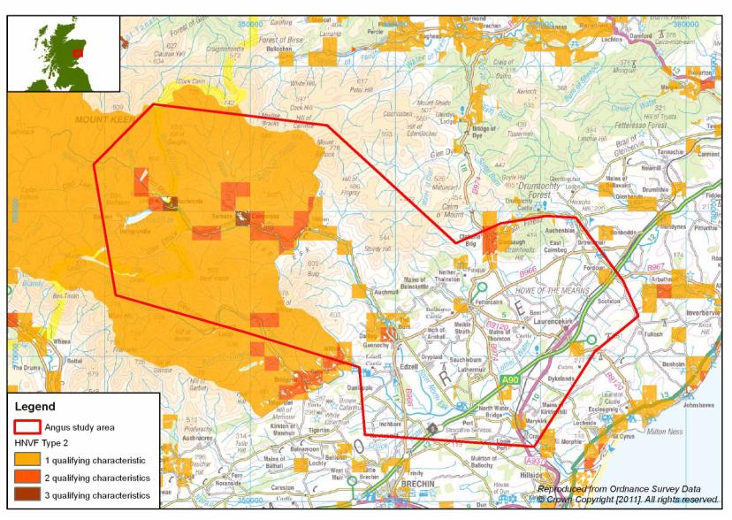
Angus study area

Slide 6
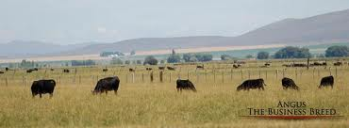
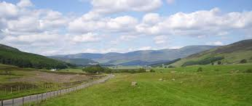
Angus study area
Original study area
Glen Esk extension –
mainly fertile o/o arable (peas, barley, potatoes) relatively intensively managed
some improved grassland and small patches of woodland
pedigree cattle breeding
cattle winter housed
Good AES uptake e.g. beetle banks
Relatively little HNVF
water margin poor indicator
estate owned high altitude heather hill
Limited enclosed/improved grassland in valley floor
Estate ownership and management specifically for grouse and other game significantly influences grazing regimes e.g. Herdwick wether tick mops, no cattle
Significant HNVF
Notes:
Glen Esk farmer: “In terms of crops, we can only really grow grass, but what we do grow very well is nature. Our asset isn’t rich, deep soil but the rich diversity of different habitats and all the wildlife that supports. Bogs, heather hill, patches of woodland, shelterbelts, the main river, burns, even the grassland we manage and cut – it all supports different species which people often under-value.”
Lowland farmer: “If things are going right, as they are for us at present, why change? Unless changes are forced on us, we’ll carry on as we are. But we’re in a privileged position here on good ground. You’d get a very different answer if you asked the boys on the hills or up the glens who are really struggling.”

Slide 7
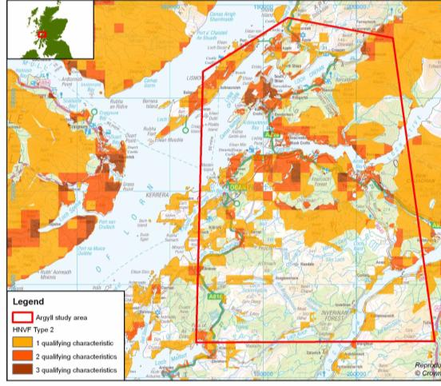
Mid-Argyll study area
(between Oban and Lochgilphead)
traditionally dairy and crofting along coastal strip (both now ceased)
previously crofted areas with remnants of many small fields = 3 HNVF characteristics
low intensity land use and management, v. wet
trend of amalgamation, increasing farm size
larger hill farms now sandwiched between extensive tracts of mainly coniferous forestry (35% of land cover in Mid-Argyll)
pockets native Atlantic oakwood, wetland
Notes:
Reduced sheep nos. (100,000 fewer sheep around Oban than 3 years ago), but lambs now often overwintered at home (due to costs)
N usage typically low but limited info. - few have ‘target’ level of N, P, K. Increased reliance on organic sources but lack of winter-housing means slurry and FYM were generally not available.
Can grow cereals but not harvest them – too wet

Slide 8
Key points from Mid-Argyll
Field size misleading indicator (skewed by common grazing and hill parks)
Artificial fertiliser use low, concentrated on mown inbye, lack of winter housing limits organic N
most inbye on free draining gravels, hence never drained (past drainage therefore poor indicator)
Shift from hay to silage
Notes:
“When farmers met up they used to swap stories about foxes and lamb prices. Now it’s recipes. If our wives weren't working, we wouldn't be farming any more. The cooking is now down to us because our wives are away out earning enough to subsidise us to keep trying to eke out a living from the land.“

Slide 9
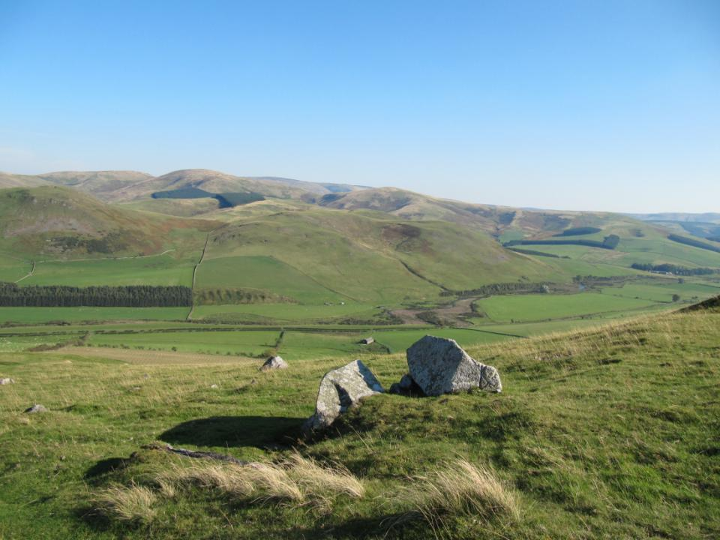

Roxburgh study area
(northern Cheviot foothills)
Mixed farming – intensively farmed alluvial flood plains (arable, grass), sheep/sucklers on hill above
Margin between HNVF Type 1 hill and intensive arable towards Kelso
Farming characteristics vary greatly between farms and in short distance
Area of flux between arable and grassland
Type 2 HNVF (wetland, rush pastures, species rich grass) on steep slopes and wet valley floors
Notes:
Very rural, agriculture mainstay of economy, surprisingly remote
Dry micro-climate, which management has to gear towards – becoming increasingly dry
Land use has varied over time and will do so in future. Most of the land which can be ploughed has already been ploughed. One farmer used to grow cereals for feeding to their own cattle, but their land limited yield to 5t/ha. Once set-aside was introduced and cereal prices dropped, it became cheaper to buy in barley, so the land which had been under cereals reverted to grass. As cereal prices have now risen sharply, in future they plan to sow more cereals to reduce costs of winter feed for their sucklers.
Lupins and triticale new introductions – partly to support change to continental cattle

Slide 10
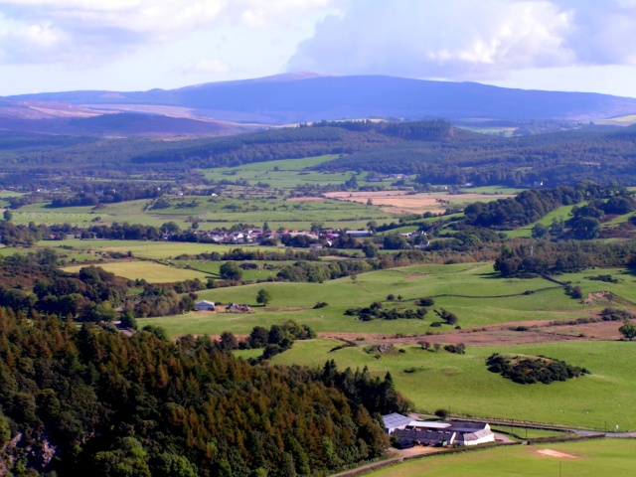
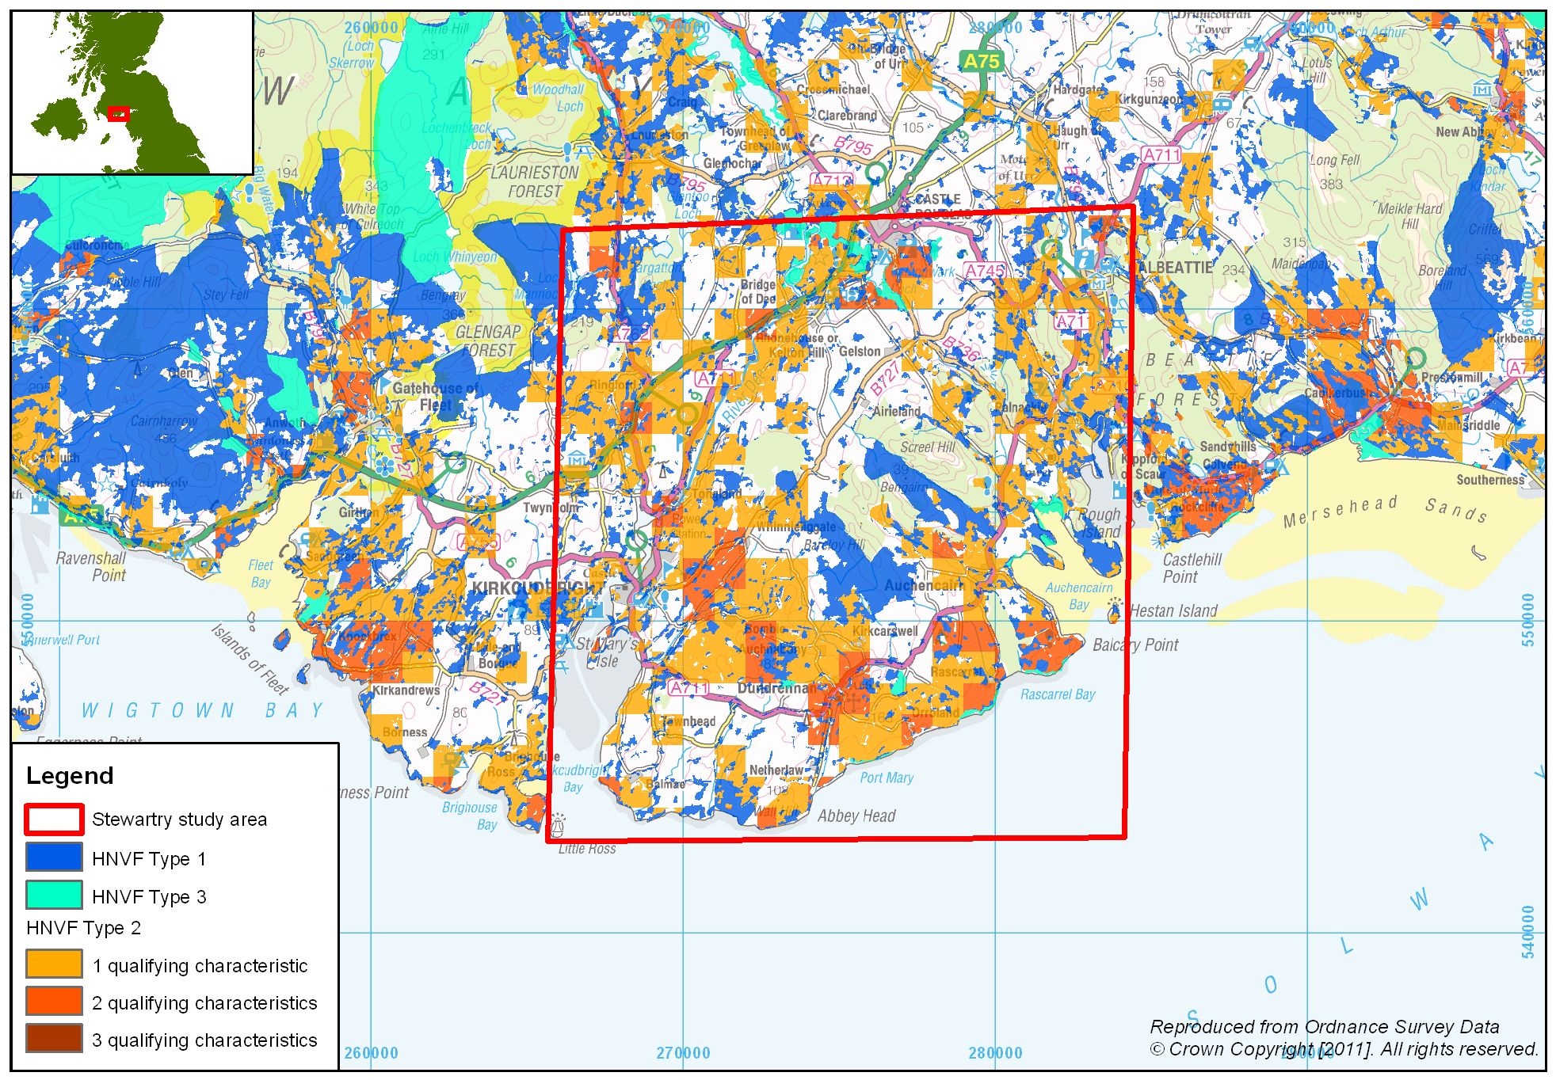
Stewartry study area
Low ground typically intensively managed grass leys separated by hedges and dykes, high stocking rates, high N use, unlikely to be HNVF
On the same holding or farm, hill or rough ground receives very little, if any, fertiliser and is stocked comparatively lightly (although field sizes quite large)
Pockets semi-natural scrub, woodland

Slide 11
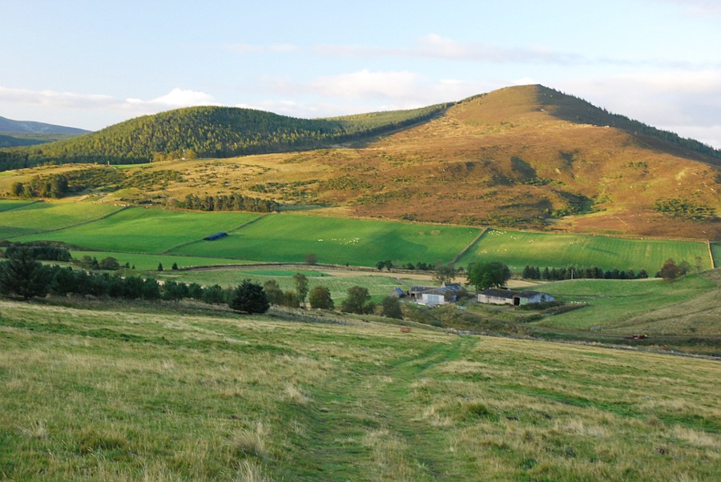

Strathdon study area
Transition area between highlands to west and intensive agriculture to east (arable common further east)
High proportion hill: inbye hence mainly sheep with some sucklers
Organic farm was the most intensively managed
Notes:
Valley of the Don - East of Braemar, Cairngorms foothills
Land use changes quickly as glen broadens out

Slide 12
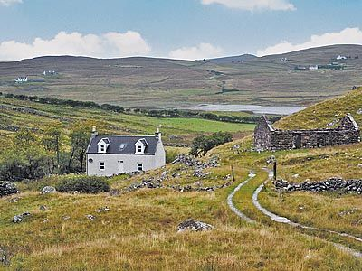

Sutherland study area
Most crofters have >1 croft
Many graze areas not declared on IACS on ad hoc or informal basis
Most crofted land and some apportionment previously drained
Inbye typically very intensively grazed or abandoned
Few use common grazing rights
Notes:
Drainage poor indicator
Overall stocking density poor indicator – if include common grazing rights (particularly as many no longer use)

Slide 13
Trends in land use and farming systems with significant implications for HNVF
HNVF negative
Reduced labour
Ageing agricultural workfore
Amalgamation farms and crofts
Reductions in enterprise diversity
Abandonment crofted ground
HNVF positive
Reintroduction small areas of arable cropping on interface between hill / low ground
Reduced use of inorganic fertiliser
Fencing cleughs and ravines
Notes:
Survey identified numerous including reductions in labour, ageing agricultural workforce, amalgamation of farms and crofts, reduction in enterprise diversity, afforestation of hill ground, abandonment of some crofted ground and market-led changes from traditional native breeds of cattle and sheep to continental breeds. Changes in management practice include reduced use of common grazing and change from hay to silage production, as well as some changes with more positive consequences for HNVF, such as reduced inorganic fertiliser usage, and reintroduction of small arable acreages on farms on the interface between hill and lowland.

Slide 14
Trend | Driver | Implications for HNVF
Traditional breeds -> continental breeds | Market demand for larger, less fat carcasses | Reduced hill cattle grazing Increased pressure on inbye/enclosed land
Change from hay to silage | Wetter climate Less time (off-farm work, amalgamation farms) | Earlier cutting Increased fertiliser
Reduced use of common grazing | - Average age crofters now 70+ - Incomers lack experience - Health restrictions and disease concerns | Increased pressure on enclosed land Reduced grazing on common ground
Cessation cutting in crofting areas | Lack machinery or contractors | Reduced capacity to keep cattle due to costs buying winter feed.
Decreased used inorganic fertiliser | High fertiliser prices | Reduced silage cuts, increased use slurry/FYM
Conifer afforestation | Grants Reduced profitability livetock farming | Habitat change
Fencing cleughs and ravines | AES incentives Labour reduction Easier gathering | Allows native woodland regen.
Notes:
Many of these trends have much more significant and far-reaching implications e.g. see next slide

Slide 15
Implications of change from traditional to continental breeds
Higher nutritional requirements
Larger less hardy continental breeds/crosses (particularly beef)
Need for better quality silage/haylage
Earlier cutting dates (June cf. July)
Environmental effects
Restricts flowering and seed setting native grass/herb sp.
Affects nesting success some grassland birds
Higher fertiliser requirements to stimulate growth pre-cutting
Increased risk fertiliser run-off
Notes:
Emphasis of hay/silage production for traditional breeds = maximising volume of dry matter
Continental breeds/crosses need better quality hay/silage to sustain through winter

Slide 16
Examples of variables considered in data analysis
Farm size
No. farm units
Time under present management
Tenure
Farm system and organic status
Land use, drainage, fertiliser use and stocking rate
Enterprises and respective contribution to income
Field size
Labour
Participation in AES
Advisory history
Past and future changes
Joint management with neighbours
Game/shooting interest
Type of grazing livestock (suckler beef, sheep)
Breed of livestock
Housing of cattle
Ratio of ‘improved’ to ‘unimproved’ ground
Frequency of cutting of grass for forage
Timing of cut(s)
Cropping pattern
Ratio of winter:spring sown crops
Recent drainage
Reseeding policy
Labour:acreage ratio
Proportion of family labour

Slide 17
Stocking Rate
Upside
Downside
Most reliable HNVF indicator
Reflects low productivity semi-natural habitat
Clear link with N use and ‘agriculturally-improved’ land
Stocking rate for overall holding masks variation between enclosed and hill ground
Not an easy concept to apply to open, shared, hill, rough grazing
Varies between and within grazing season
Notes:
Typically reflects low productivity semi-natural habitat such as hill ground and rough grazing, or unimproved enclosed grassland because low stocking rates are less dependent on high levels of fertiliser application necessary to stimulate and maintain high productivity.
Difficult measure to derive consistently and accurately. Dairy and more intensive farmers may plan and manage according to calculated stocking density, but few hill farmers, or lowland sheep or beef farmers are able to quote accurate stocking density for their farm, and never in relation to specific sub-areas of their farm.
Management of more extensive farms is usually on a more ad hoc practical basis.
Farm stocking density provided a much cruder indicator of nature conservation value of upland, not least because of the inclusion of common grazing rights.

Slide 18
Use of Inorganic Nitrogen
Upside
Downside
Good indicator of HNVF/non-HNVF
Clear effect on agricultural and biodiversity output
More easily measured than stocking rate
Ignores organic matter
Tends to overestimate HNVF value of intensive organic farms (e.g. dairy)
Can vary significantly with season and price
Difficult to monitor
Notes:
Ditto for Inorganic N
Although NVZs and the many nutrient budgeting projects and programmes which are running successfully around the country provide positive examples of monitoring nutrient levels, at present type and level of fertiliser is not captured by IACS.

Slide 19
Average field size/boundary length
Upside
Downside
Comparatively easy to map (in theory)
Indirect link with HNVF
Average masks wide variation
Meaningless on hill, rough, common or shared grazings
Hill parks and apportionment better excluded
Ignores comparative HNVF / conservation value of different boundary types (e.g. hedges vs fences)
Notes:
Ditto
Small fields inhibit mechanisation but are not necessarily diverse in terms of land cover, land use or habitat type
Large fields, particularly upland inbye, often include a wide diversity of land cover (inc. wetland, woodland, unimproved and improved grass)
Many enclosed small fields are more intensively managed or over-grazed than larger (often rougher) fields

Slide 20
Habitat Diversity
Upside
Downside
Potentially direct measure of HNVF
Enables differentiation of Types 1, 2 and 3
‘Fallow’ is an indicator used across Europe
Depends on availability of appropriate data
Overlap of HNVF types 1, 2 and 3
‘Fallow’ not really relevant to Scotland
Notes:
Ditto
- Alternative break crops largely replaced fallow.
Much of the land which might 10 years ago have been classed as fallow was in fact set-aside, which disappeared once it was no longer an EC subsidy requirement.
Habitat diversity irrelevant as indicator in Scotland if based on different cropping types, but potentially relevant if based on semi-natural habitat

Slide 21
HNVF indicators
HNVF is a ‘whole-farm’ concept
HNVF value can differ across the farm
Accurate identification of HNVF relies on many indicators
Drivers of HNVF-type management are a mix of financial drivers (e.g. fertiliser cost, corn prices) and personal factors (e.g. health, age)
Notes:
- HNVF permeates or has implications for the whole of the farm and how it is managed, rather than just isolated to certain features, enterprises or parts of the farm.
HNVF can only be identified by looking at a combination of measures and indicators, rather than any one in isolation. Even then, associations of particular indicators are not 100% reliable.
limited sample in terms of number of farms and area of land they manage do not allow statistically robust conclusions to be drawn for Scotland as a whole.

Slide 22
General Farm Characteristics
HNVF Likelihood High
HNVF Likelihood Low
Beef suckler and/or sheep
Traditional breeds
Outwintered/grazed all year
Substantial area of hill/rough grazing
Single late cut of forage
Enclosed fields are small
Low N use
Mainly family labour
Spring sown combinable crops (in areas where arable still viable)
Beef, sheep, dairy, arable
Continental breeds
Cattle in-wintered
Mixed cropping
Agriculturally-improved land
Multiple silage cuts
Large fields
High N use
Non-family labour and contractors
Less likely to be in AES
Notes:
- Attempt to produce portrait typifying HNVF and non-HNVF farms/crofts
- Receipt of conservation or other advice has for many farms been a pre-requisite for entry to AES, but is not necessarily an indicator of interest in or commitment to HNVF, although many HNVF type farms have previously benefitted from AES support for maintaining or reintroducing sympathetic management of boundary features, grassland or other habitat management.

Slide 23
Key characteristics of HNVF
limited scope for change in farm enterprise or management as a result of location, climate, topography and the nature of the area
dominated by habitats and farming systems which support high biodiversity
farming systems which simultaneously maintain cherished landscape and are essential to rural social structure
“There’s nothing much we can change – you can’t change nature”
“We do our best with what the ground is fit for and that’s it. We don’t have any other choices here in terms of agricultural production.”

Slide 24
Survey conclusions
Survey confirmed vulnerability of marginal farming areas.
Type 2 HNVF farms typically physically on the interface of more productive agricultural ground and mountains, also marginal in economic terms.
Agricultural land capability may be useful HNVF indicator.
Endorses need to identify mechanisms such as HNVF which effectively target support at appropriate farms and crofts.
Notes:
Land capability mapping discussed at outset of project but not compared with HNVF maps – potential for further consideration, particularly as key characteristic of HNV farms is that they are wholly (Type 1) or partly (Type 2) in agriculturally challenged areas.
Scope for further discussion what might be the best form of support for HNVF – geographic targetting coupled with additional intensity/land-use indicators, and/or support for specific practices considered at risk e.g. Maintaining traditional breeds, hay making, limited use of fertiliser (organic or inorganic)

