Slide 1
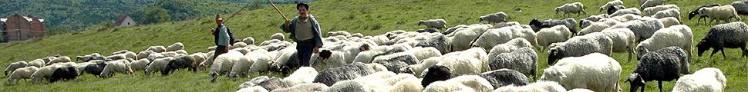

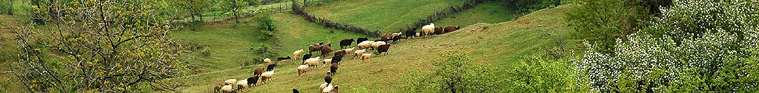
HNV farming case studies:
Devon, Carmarthenshire, Wye Valley
Guy Beaufoy
www.efncp.org
June 2012

Slide 2
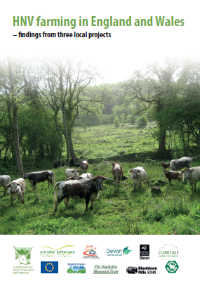
For separate case-study reports: http://www.efncp.org/projects/united-kingdom/

Slide 3
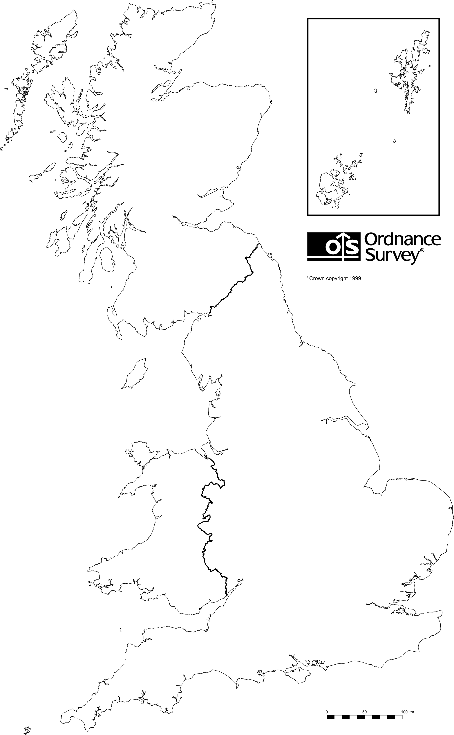
The three projects – similar challenges
East Carms
Wye Valley
Devon

Slide 4
Project aims – identifying and monitoring HNV farmland
Most work on defining and identifying HNV farming has through country and EU desk studies
But what are local perceptions of which farmland needs to be prioritised for conservation?
Can this be identified and monitored through existing data sets - how much is there, where is it, what condition?
How do national attempts at HNV farming maps look when checked at local level?
Notes:
Réseau ouvert, partenariat avec CE, EEA, JRC, ONG européennes
AScA membre du réseau
Remerciements

Slide 5
Project aims – what types of farming maintain HNV farmland?
Are there any characteristic patterns, e.g. can HNV farm « types » be defined and monitored?
What is happening to these farms/farming?
What the challenges for the maintenance of HNV farmland?
How well do current policies respond to these trends and challenges?
Notes:
Réseau ouvert, partenariat avec CE, EEA, JRC, ONG européennes
AScA membre du réseau
Remerciements

Slide 6
Focus varied from project to project
Devon
  Ground-truthing national HNV maps, analysing farming types and trends, policy response
Carmarthenshire
  Identification of semi-natural farmland using existing data and remote sensing
Wye Valley
  Tackling the challenge of semi-natural grasslands on small, non-farming holdings – local project approach and RDP funding
Notes:
Réseau ouvert, partenariat avec CE, EEA, JRC, ONG européennes
AScA membre du réseau
Remerciements

Slide 7
HNV farming in Devon project findings
Guy Beaufoy
www.efncp.org
June 2012

Slide 8
Four Devon case studies
Culm grasslands
Blackdown Hills AONB
Dartmoor
South Devon AONB

Slide 9
Partners and funding
EFNCP + DG Env funding
Devon County Council
Natural England
Devon Wildlife Trust
Blackdown Hills AONB
South Devon AONB
Dartmoor National Park

Slide 10
Steering group and additional input
RSPB
Cumulus Consultants
FWAG
Butterfly Conservation
Grasslands Trust
Notes:
Réseau ouvert, partenariat avec CE, EEA, JRC, ONG européennes
AScA membre du réseau
Remerciements

Slide 11
What sort of HNV farmland did we find?

Slide 12
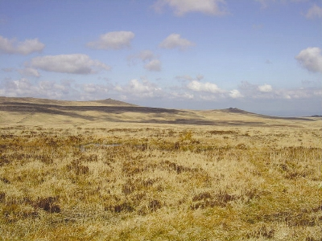
Semi-natural moorland, including common grazings, much of which is SSSI and SAC

Slide 13
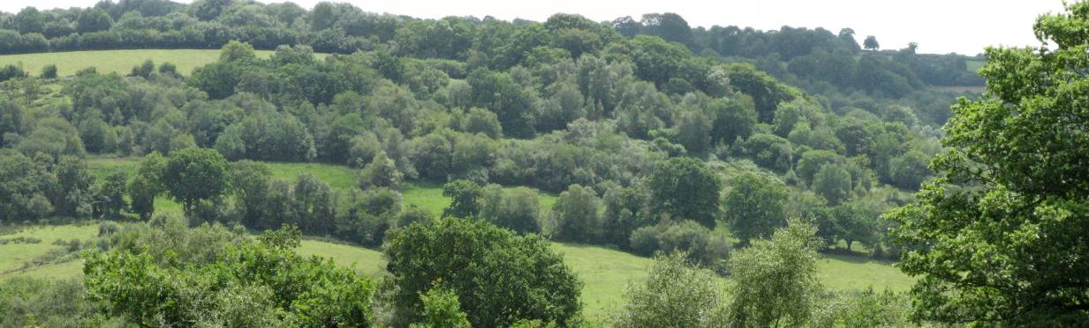
Landscapes of unimproved and semi-improved pasture, with patches of woodland, scrub and hedges
Improved pasture
Diverse rush pasture and fen meadow
Semi-improved pasture
1
2
3
1

Slide 14
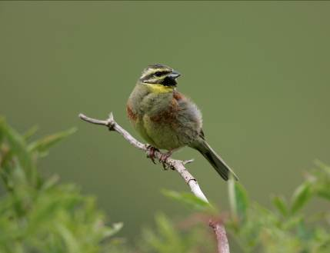
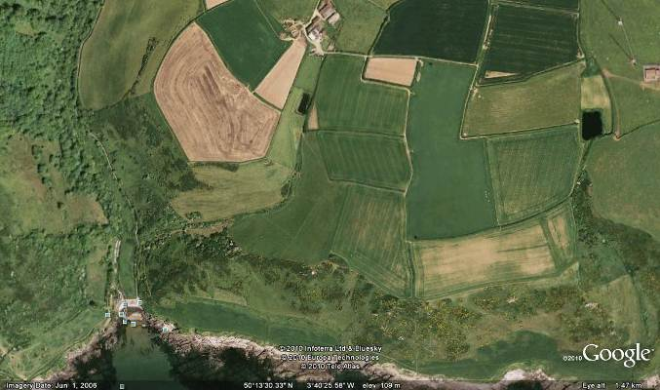
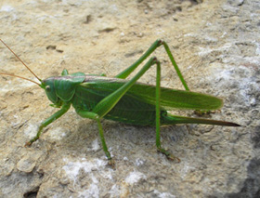
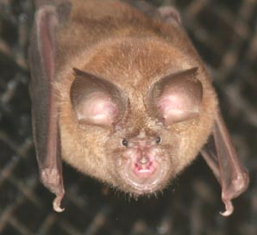
South Devon spring cereals/winter stubbles with pastures, scrub and big hedges.

Slide 15
Can HNV farmland be identified from existing NATIONAL data sets?
With certainty, only where it coincides with designated sites or inventoried BAP habitats
But there was strong consensus that this is only a small part of the total HNV farmland resource
No access to UK Land Cover 2007, which is far more powerful than 2000 version and should be tested
Notes:
Réseau ouvert, partenariat avec CE, EEA, JRC, ONG européennes
AScA membre du réseau
Remerciements

Slide 16
Can HNV farmland be identified from existing LOCAL data sets?
Locally there is more habitat and species data available than nationally
But in the wider countryside, this data is patchy and inconsistent both in space and time and across taxa
We rejected option of collating bits and pieces of species data and constructing something patchy.
Conclusion – HNV farmland identification in Devon cannot be done robustly using off-the-shelf data.
Notes:
Réseau ouvert, partenariat avec CE, EEA, JRC, ONG européennes
AScA membre du réseau
Remerciements

Slide 17
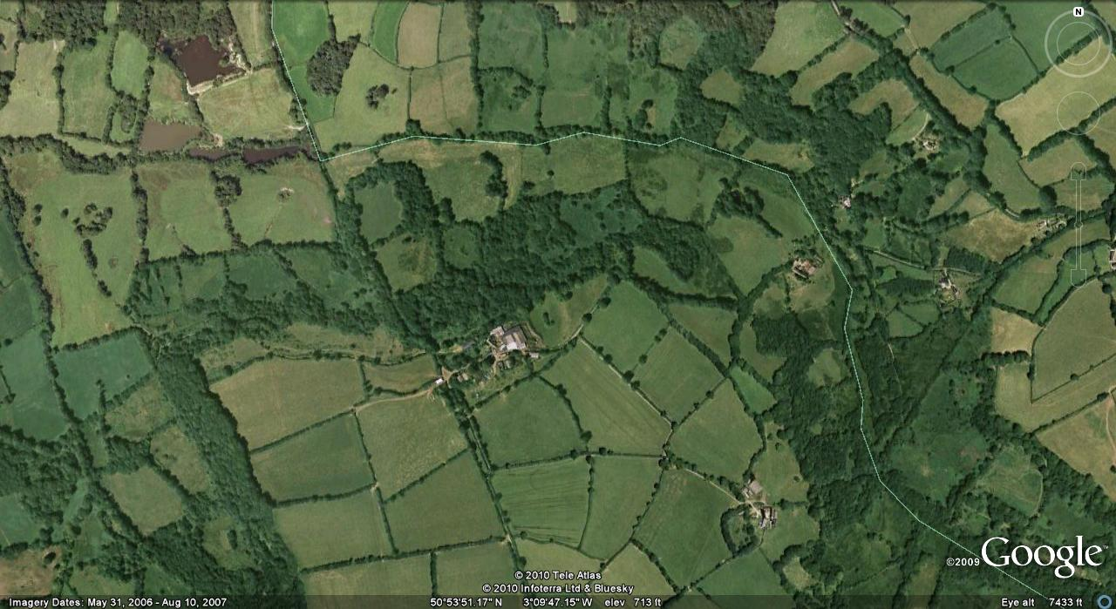
So NE did local HNV mapping using aerial photos.
The aim was to capture the wider « landscape matrix », building on inventoried habitats and County Wildlife Sites.
Field survey in Culm showed the technique is robust.
Capturing wider matrix
BAP priority habitats inventory

Slide 18
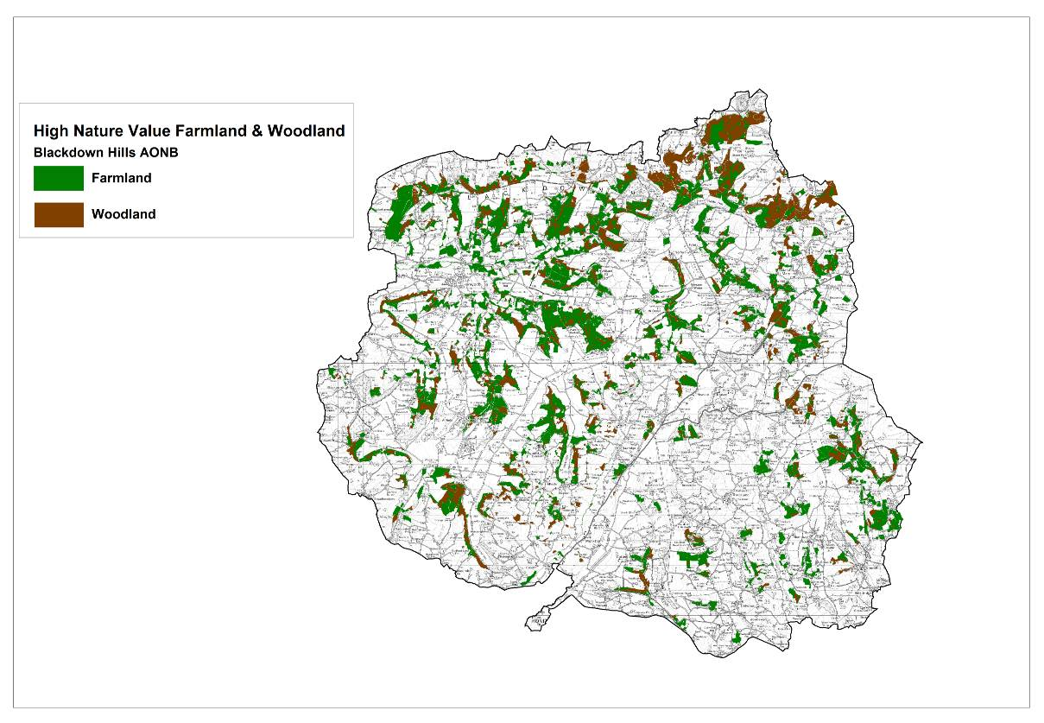
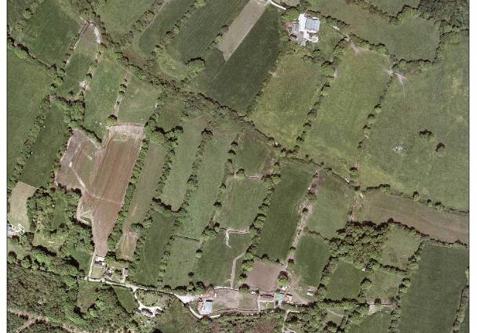
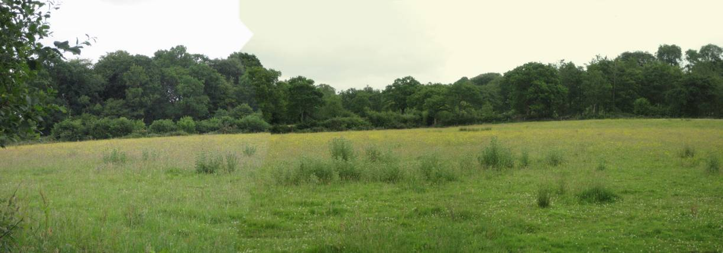
HNV farmland = 10% of Blackdown Hills AONB
Mostly Grade 4 and 5 land but not LFA

Slide 19
Extent of HNV farmland in each area according to project maps, and the % cover by designations
 | Total extent of study area ha | HNVF as % of study area | % of HNVF covered by SAC | % of HNVF covered by SSSI | % of HNVF covered by County Sites
Blackdown Hills | 36,860 | 11 | 0.1 | 10 | 47
Culm | 40,628 | 16 | 8.5 | 11 | 17
South Devon | 33,700 | 20 | 4 | 10 | 47
Dartmoor | 7,903 | 47 | 54 | 54 | 5

Slide 20
So beyond designated sites, there is a larger area of similar, broadly semi-natural farmland of high nature value. Policy should recognise this.
Farmland
Natura 2000
Local wildlife sites
HNV farmland

Slide 21
Natural England draft map of HNV farmland –priority semi-natural habitats + suites of farmland species.
Ground-truthing the big maps…
HNV map for UK based on CORINE

Slide 22
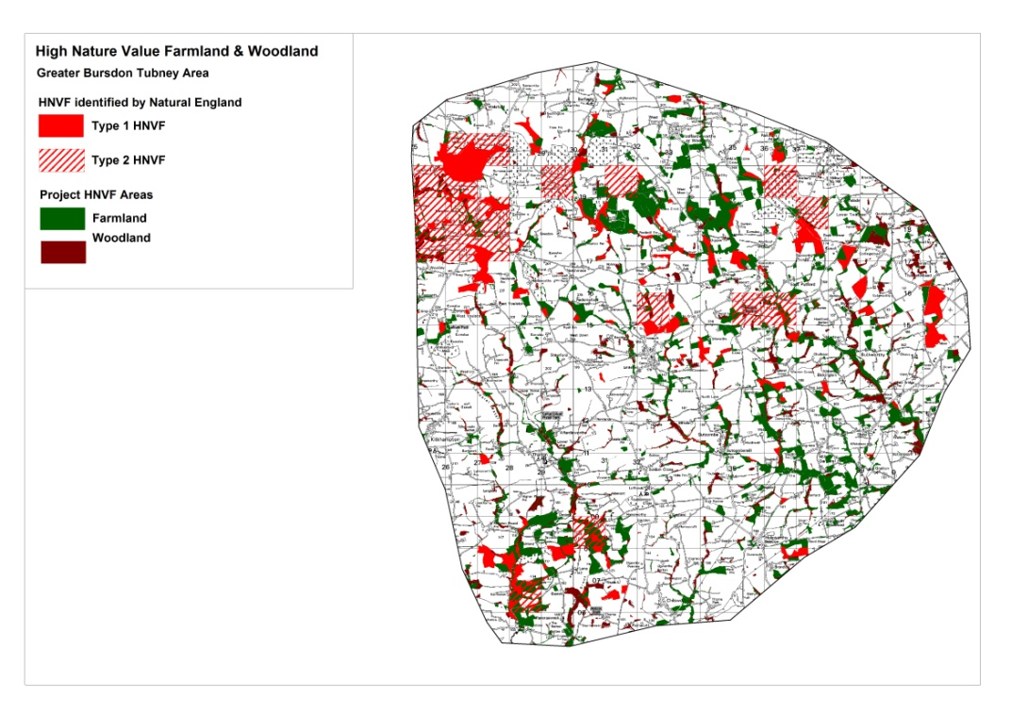
Part of Culm grassland area
NE HNV map in red, project map in green/brown
Priority habitats inventory misses large areas of semi-natural farmland

Slide 23
What sort of farms and farm types are found on the land we mapped as HNV?
We tried to characterise farms with HNV farmland using Farm Survey, RLR (LPIS), IACS
Not a great success – data handling issues, and limits to usefulness
RLR and IACS have very limited information compared with some other countries, and access problems
We need to make data systems fit for purpose in the context current rural policy aims (public goods etc.)
Notes:
Réseau ouvert, partenariat avec CE, EEA, JRC, ONG européennes
AScA membre du réseau
Remerciements

Slide 24
But some things are apparent
HNV farmland occurs across a range of farming situations
But inextricably linked with grazing livestock and more likely to be beef/sheep, though also dairy, horses, ponies
Very small and « other » category holdings are over-represented – HNV farmland often not mainstream
These holdings are more likely to be largely HNV farmland, whereas it tends to be a smaller proportion of larger commercial holdings
17% of HNV farmland and woodland is not recorded on Rural Land Register – LPIS (higher than the farmland average)
Notes:
Réseau ouvert, partenariat avec CE, EEA, JRC, ONG européennes
AScA membre du réseau
Remerciements

Slide 25
HNVF as % of Holding Size for Different Types of Farm with HNVF in the Blackdown Hills AONB (sample parishes)

Slide 26
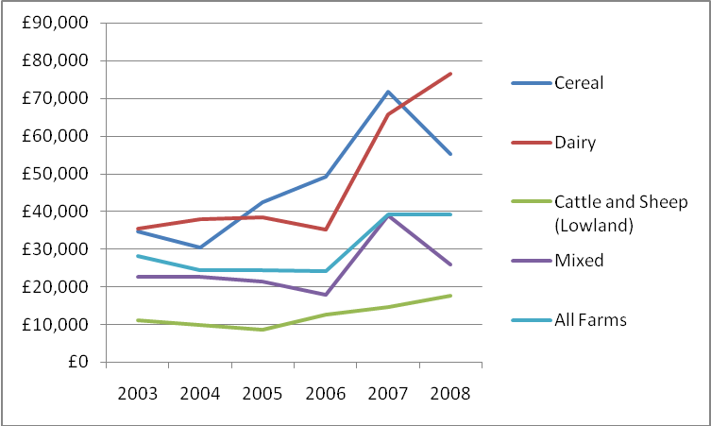
Farm income south-west England. If we are thinking strategically, where is HNV farmland on this graph?

Slide 27
What is happening? Land owning patterns
Farms are tending to sell off « poorer » land to « lifestyle landowners »
An increasing proportion of HNV farmland is on small-holdings not managed by « real » farmers.
Keeping this land in suitable grazing use is a particular challenge.
Often used for horses (intensively) or no stock available - lack of contact with farming community, lack of knowledge.

Slide 28
What is happening? – use of HNV land
A lot of positive management (especially under Higher Level AES) of HNV farmland
And some is just in active grazing use as part of wider permanent pasture, with no AES.
But on-going loss of HNV farmland, due to localised intensification, and increasingly under-use and abandonment.
Studies of the condition of CWS found that approximately 50% of grassland/heathland sites were not in favourable conservation management.

Slide 29
What are the needs and how is policy responding?
Abandonment on smaller, wetter, steeper fields with high management costs. Often not reached by AES
Basic infrastructure – fencing, water – often poor on HNV farmland.
Intensification on better land is not prevented effectively by EIA and cross-compliance
The situation and trends cannot be quantified due to lack of data and monitoring, even on County Wildlife Sites – NOTE Lawton Recommendation 12, « LAs should identify and monitor CWS and management should be improved ».

Slide 30
HNVF in agri-environment schemes – less than farmland as a whole?
 | % of all land in AES (current and classic schemes) | % of HNV farmland in AES (current and classic schemes) | % HNV farmland in current Higher Level Scheme | % of HNV farmland in “classic” schemes
Blackdown Hills | 47.2 | 46 | 11.5 | 13
Culm | 67.5 | 61 | 18 | 17
South Devon | 66 | 70 | 19 | 26
Dartmoor | 83 | 78 | 76 | 8

Slide 31
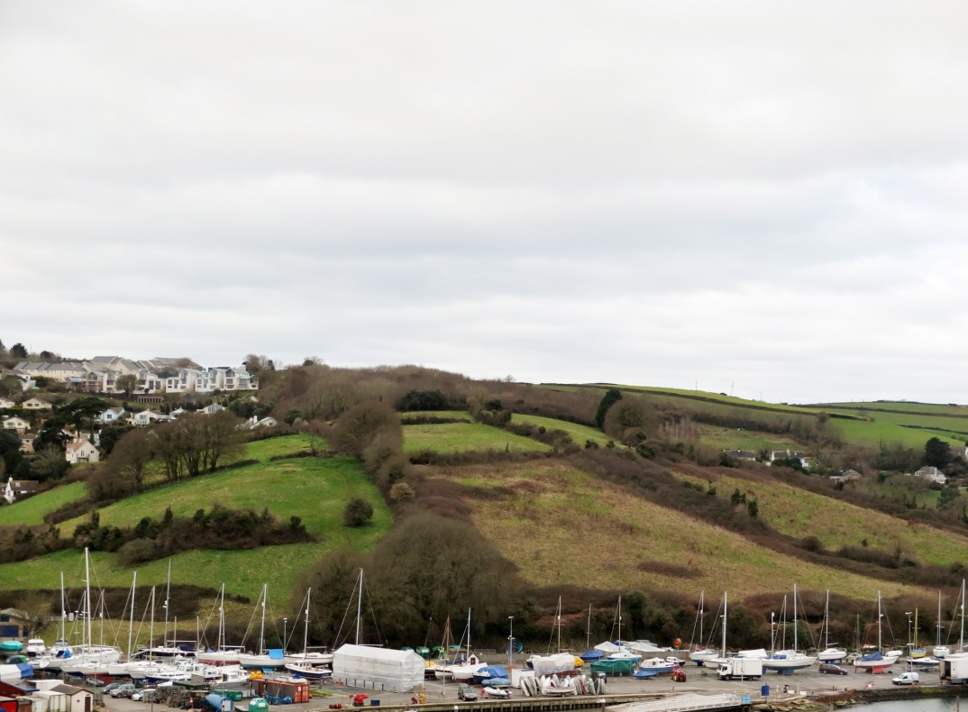
County Wildlife Site in South Devon, out of farming since 1990s, gradual scrubbing up.
Not addressed by current policies..

Slide 32
CAP Pillar 1 – recommendations
Pillar 1 is especially important for incomes of beef and sheep enterprises, so any phasing out is a worry
A top-up to Pillar 1 payments should be payable on HNV farmland, especially permanent pasture under low-intensity management [ELS – EK2]
This should be separated on RLR/IACS from permanent pasture under intensive management
Cross-compliance protection of semi-natural grassland should be improved through tighter application of EIA (facilitated by separate recording on RLR/IACS)

Slide 33
RDP –recommendations
RDPE should highlight the types of farmland and farming of particular nature value. This land extends far beyond SSSI and CWS in some regions.
RDPE ex-ante analysis should highlight processes of abandonment and intensification occurring on semi-natural farmland outside nationally designated sites (cf Lawton – “under-managed”).
RDPE should aim to prevent further loss of HNV farmland to these processes; and to restore HNV farmland at the landscape scale.
A system should be set up for monitoring changes to the extent, condition and management of HNV farmland.

Slide 34
RDPE – measures
Many positive effects from AES but schemes complex, coverage of HNV farmland no better than average.
AES need more resources, including for delivery, simplified options and administrative processes.
Needs middle way between ELS and HLS. For example, add capital payments to ELS.
Facilitate links with farm business investment grants where viability of HNV farmland can be improved.
Local NGO action makes a huge difference. Funding stream needed for local projects, especially to address HNV land that is difficult to tackle through top-down schemes.

